Slide 1
Hospital Database System
Presented By:
Saif Essam
Youssef Hatem

Slide 2

Do hospitals really care about patients?

Slide 3
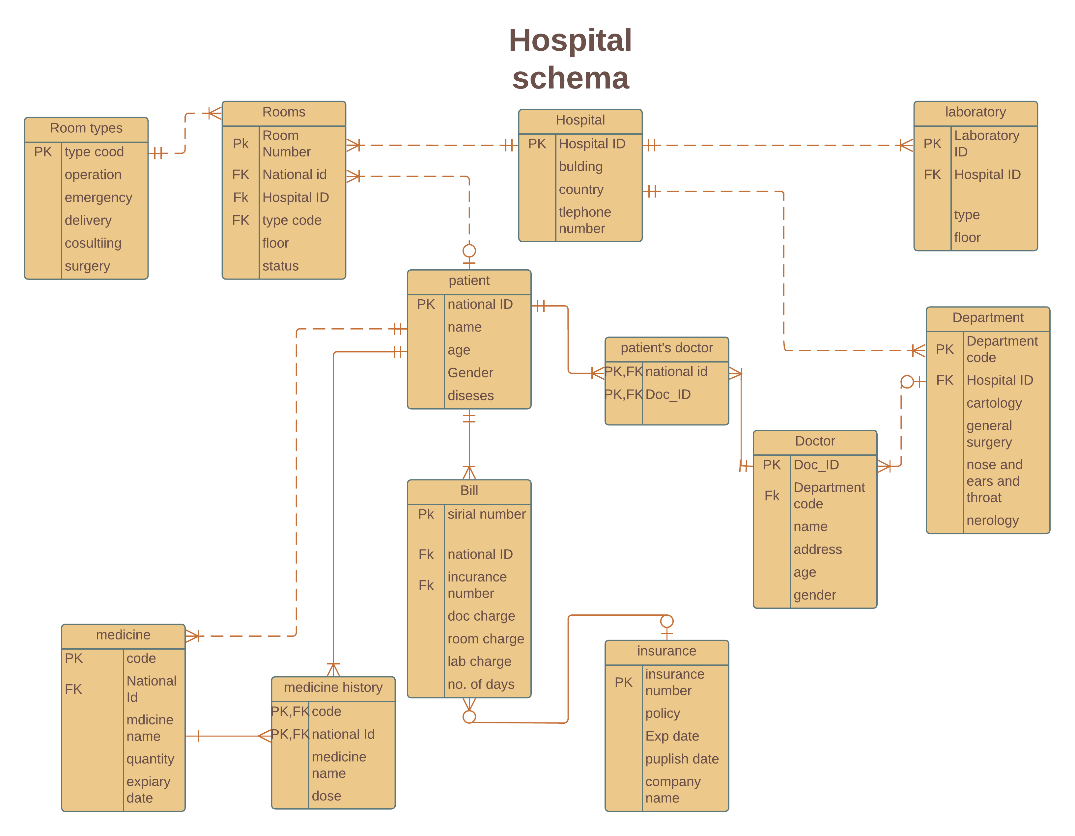

Slide 4

Creating Tables
CREATE TABLE Hospital
(Hospital_ID INTEGER PRIMARY KEY,
[Building] TEXT(50) NOT NULL,
[Country] TEXT(50) NOT NULL,
Phone TEXT(11),
Email TEXT(50));

Slide 5

Hospital Table
Hospital
Hospital_ID | Building | Country | Phone | Email
142023 | 14 | Egypt | 01500111011 | ysf23@gmail.com

Slide 6

Inserting Hospital Values
INSERT INTO Hospital
VALUES ('142023', '14', 'Egypt', '01500111011', 'ysf23@gmail.com');

Slide 7

Creating Room table
CREATE TABLE Room
(Room_Number INTEGER CONSTRAINT PK_Room_Number PRIMARY KEY,
Hospital_ID INTEGER NOT NULL CONSTRAINT FK_Hospital_ID
REFERENCES Hospital (Hospital_ID),
Type_Code INTEGER NOT NULL CONSTRAINT FK_Type_Code
REFERENCES Room_Type (Type_Code),
National_ID INTEGER NOT NULL CONSTRAINT FK_National_ID
REFERENCES Patient (National_ID),
Statuse TEXT(5),
Floor NUMBER);

Slide 8
Room table
Room
Room_Number | Hospital_ID | Type_Code | National_ID | Statuse | Floor
102 | 142023 | 112 | 30101111 | Busy | 2
103 | 142023 | 113 | 30101112 | Busy | 3
104 | 142023 | 113 | 30101113 | Busy | 3
105 | 142023 | 114 | 30101114 | Busy | 4
106 | 142023 | 114 | 30101115 | Empty | 4
107 | 142023 | 114 | 30101116 | Empty | 4
108 | 142023 | 114 | 30101117 | Busy | 3
109 | 142023 | 114 | 30101118 | Empty | 3

Slide 9
Inserting Values
INSERT INTO Room
VALUES (0102, '142023', ‘0112', '30101111', ‘Busy', ‘2');

Slide 10

Creating Medicine History Table
CREATE TABLE Medicine_History
(National_ID INTEGER NOT NULL CONSTRAINT FK_National_ID
REFERENCES Patient (National_ID),
Medical_Code INTEGER NOT NULL CONSTRAINT FK_Medical_Code
REFERENCES Medicine(Medical_Code),
CONSTRAINT PKMedicineHistory PRIMARY KEY (National_ID,Medical_Code))

Slide 11

Medicine History Table
Medicine_History
National_ID | Medical_Code
30101111 | 132
30101112 | 133
30101113 | 134
30101114 | 135
30101115 | 136

Slide 12
Creating Other Tables
CREATE TABLE Bill
(Sirial_Number INTEGER CONSTRAINT PK_Sirial_Number PRIMARY KEY,
Incurance_Number INTEGER NOT NULL CONSTRAINT FK_Incurance_Number
REFERENCES Incurance (Incurance_Number),
National_ID INTEGER NOT NULL CONSTRAINT FK_National_ID
REFERENCES Patient (National_ID),
Doctor_Charge NUMBER,
Room_Charge NUMBER,
Laboratory_Charge NUMBER,
Number_Of_Days Number);
Bill
Sirial_Number | Incurance_Number | National_ID | Doctor_Charge | Room_Charge | Number_Of_Days
162 | 142 | 30101111 | $700.00 | $0.00 | 0
163 | 143 | 30101112 | $1,000.00 | $500.00 | 4
164 | 144 | 30101114 | $2,200.00 | $1,500.00 | 7
165 | 145 | 30101118 | $1,600.00 | $600.00 | 5

Slide 13
CREATE TABLE Department
(Department_Code INTEGER CONSTRAINT PK_Department_Code PRIMARY KEY,
Hospital_ID INTEGER NOT NULL CONSTRAINT FK_Hospital_ID
REFERENCES Hospital (Hospital_ID));
Department
Department_Code | Hospital_ID
121 | 142023
122 | 142023
123 | 142023
124 | 142023

Slide 14
CREATE TABLE Doctor
(Doctor_ID INTEGER CONSTRAINT PK_Doctor_ID PRIMARY KEY,
Department_Code INTEGER NOT NULL CONSTRAINT FK_Department_Code
REFERENCES Department (Department_Code),
Age NUMBER,
SEX NUMBER,
Gender TEXT(5),
Address TEXT(20));
Doctor
Doctor_ID | Department_Code | Age | Gender | Address
151 | 121 | 47 | Male | Giza
152 | 122 | 59 | Male | Faisal
153 | 123 | 35 | Femal | Haram
154 | 121 | 48 | Femal | Dokki
155 | 124 | 68 | Male | Giza
156 | 122 | 63 | Femal | Dokki
157 | 121 | 66 | Male | Giza
158 | 124 | 32 | Male | Haram
159 | 123 | 57 | Femal | Haram
1510 | 124 | 36 | Femal | Faisal
1511 | 122 | 46 | Male | Maadi
1512 | 123 | 52 | Femal | Maadi

Slide 15
CREATE TABLE Insurance
(Insurance_Number INTEGER PRIMARY KEY,
Policy TEXT(50) NOT NULL,
Expairy_Date Date NOT NULL,
Puplich_Date Date NOT NULL,
Incurance_Company Text(30));
Insurance
Insurance_Number | Policy | Expairy_Date | Puplich_Date | Incurance_Company
141 | Mediclaim Plans | 12/25/2030 | 12/25/2020 | Misr Insurance
142 | Mediclaim Plans | 10/22/2030 | 10/22/2020 | AXA Egypt Insurance
143 | Mediclaim Plans | 8/16/2032 | 8/16/2022 | Allianz Insurance
144 | Mediclaim Plans | 2/10/2032 | 2/10/2022 | Allianz Insurance
145 | Critical Illness Insurance Plans | 1/12/2032 | 1/12/2022 | Allianz Insurance

Slide 16
CREATE TABLE Medicine
(Medical_Code INTEGER CONSTRAINT PK_Medical_Code PRIMARY KEY,
National_ID INTEGER NOT NULL CONSTRAINT FK_National_ID
REFERENCES Patient (National_ID),
Medicine_Name TEXT,
Quantity NUMBER);
Medicine
Medical_Code | National_ID | Medicine_Name | Quantity
132 | 30101111 | Fexofenadinel | 3
133 | 30101112 | Buscopan | 1
134 | 30101113 | aspirin | 2
135 | 30101114 | acetaminophen | 1
136 | 30101115 | ibuprofen | 2

Slide 17
CREATE TABLE Patient
(National_ID INTEGER PRIMARY KEY,
[Last Name] TEXT(50) NOT NULL,
[First Name] TEXT(50) NOT NULL,
Disese TEXT(10),
Age NUMBER,
Gender TEXT(5));
Patient
National_ID | Last Name | First Name | Disese | Age | Gender
30101111 | Essam | Ahmed | Allergies | 53 | Male
30101112 | Ahmed | Sara | Stomach Ac | 29 | Femal
30101113 | Mostafa | Nayera | Headaches | 48 | Femal
30101114 | Reda | Mostafa | COVID-19 | 67 | Male
30101115 | Ahmed | Sayed | COVID-19 | 61 | Male
30101116 | Ahmed | Safia | COVID-19 | 74 | Femal
30101117 | Sultan | Ahmed | COVID-19 | 32 | Male
30101118 | Sayed | Sara | COVID-19 | 82 | Femal

Slide 18
CREATE TABLE Patient_and_Doctor
(Doctor_ID INTEGER NOT NULL CONSTRAINT FK_Doctor_ID
REFERENCES Doctor (Doctor_ID),
National_ID INTEGER NOT NULL CONSTRAINT FK_National_ID
REFERENCES Patient (National_ID),
CONSTRAINT PKPatient_and_Doctor PRIMARY KEY (Doctor_ID,National_ID))
Patient_and_Doctor
Doctor_ID | National_ID
152 | 30101111
155 | 30101117
158 | 30101114
158 | 30101116
158 | 30101118
159 | 30101113
1510 | 30101115
1512 | 30101112

Slide 19
CREATE TABLE Room_Type
(Type_Code INTEGER PRIMARY KEY);
Room_Type
Type_Code
111
112
113
114

Slide 20


Dropping Laboratory Table
DROP TABLE Laboratory;

Slide 21
Dropping Lab Values
ALTER TABLE Bill
DROP COLUMN Laboratory_Charge;

Slide 22

Altering Bill table
ALTER TABLE Bill
ALTER COLUMN Doctor_Charge CURRENCY;

Slide 23

Updating Room Statues
UPDATE Room SET Statuse = 'Busy'
WHERE Room_Number = 108;

Slide 24
Updating room statues
Room
Room_Number | Hospital_ID | Type_Code | National_ID | Statuse | Floor
102 | 142023 | 112 | 30101111 | Busy | 2
103 | 142023 | 113 | 30101112 | Busy | 3
104 | 142023 | 113 | 30101113 | Busy | 3
105 | 142023 | 114 | 30101114 | Busy | 4
106 | 142023 | 114 | 30101115 | Empty | 4
107 | 142023 | 114 | 30101116 | Empty | 4
108 | 142023 | 114 | 30101117 | Empty | 3
109 | 142023 | 114 | 30101118 | Empty | 3
Room
Room_Number | Hospital_ID | Type_Code | National_ID | Statuse | Floor
102 | 142023 | 112 | 30101111 | Busy | 2
103 | 142023 | 113 | 30101112 | Busy | 3
104 | 142023 | 113 | 30101113 | Busy | 3
105 | 142023 | 114 | 30101114 | Busy | 4
106 | 142023 | 114 | 30101115 | Empty | 4
107 | 142023 | 114 | 30101116 | Empty | 4
108 | 142023 | 114 | 30101117 | Busy | 3
109 | 142023 | 114 | 30101118 | Empty | 3

Slide 25

Average Doctor Charge
SELECT Doctor_ID, Count(*) AS charge_of_doctor, Avg(Doctor_Charge) AS [Average Doctor charge]
FROM Bill
GROUP BY Doctor_ID;

Slide 26
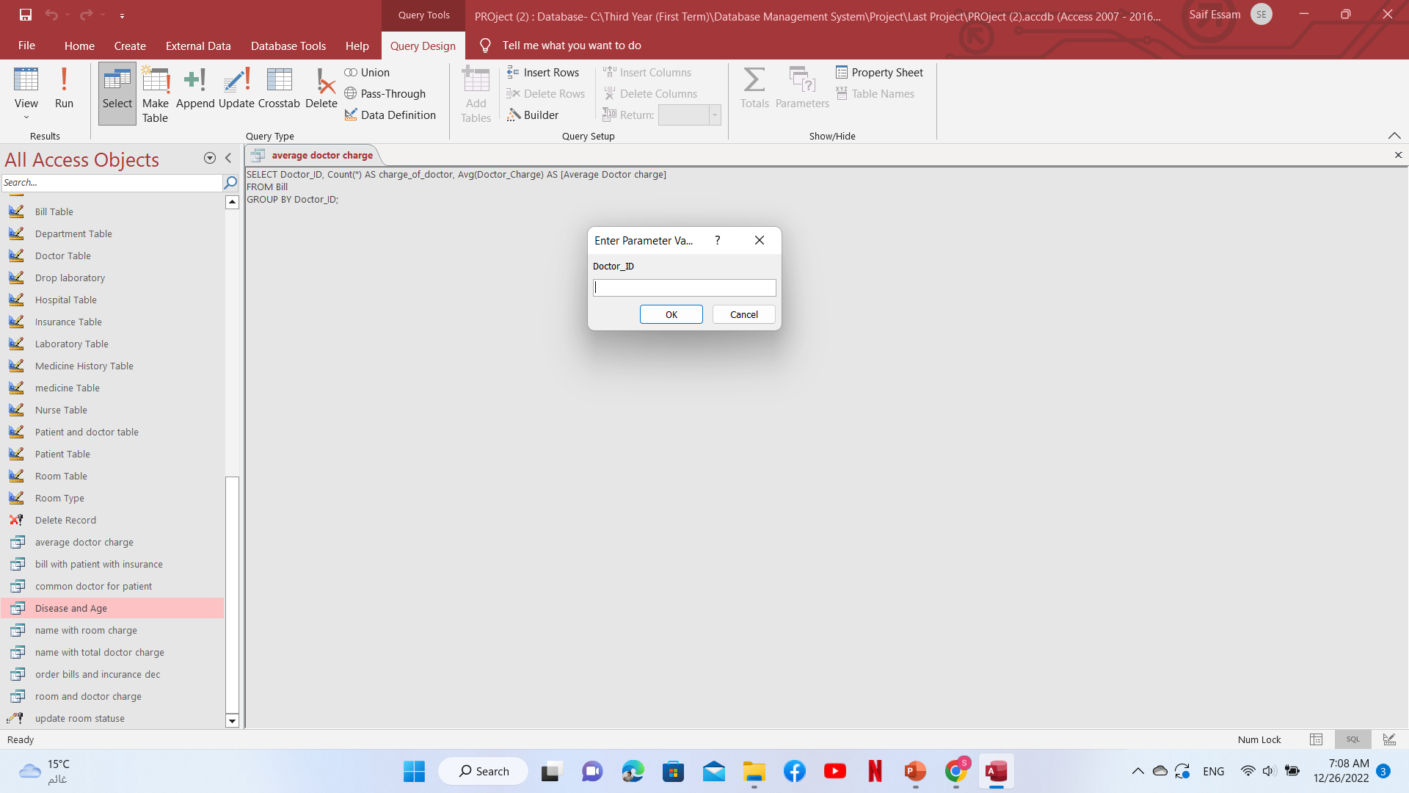
Average Doctor Charge

Slide 27
Average Doctor Charge
average doctor charge
Doctor_ID | charge_of_doctor | Average Doctor charge
158 | 4 | $1,375.00

Slide 28

Age and disease
SELECT Patient.Disese, Patient.Age
FROM Patient
WHERE (((Patient.[Age])>60));

Slide 29

Age and Disease
Age and Disease
Disease | Age
COVID-19 | 67
COVID-19 | 61
COVID-19 | 74
COVID-19 | 82

Slide 30

Patient name with Dr’s charge
SELECT [First Name] & ', ' & [Last Name] AS Name, IIF(Sum(Doctor_Charge) IS NULL,'NONE',Sum(Doctor_Charge)) AS Total
FROM Patient LEFT JOIN Bill ON Patient.National_ID=Bill.National_ID
GROUP BY [First Name] & ', ' & [Last Name];

Slide 31
Patient name with Total Dr’s charge
Patient Name With Total Doctor Charge
Name | Total
Ahmed, Essam | 700
Ahmed, Sultan | NONE
Mostafa, Reda | 2200
Nayera, Mostafa | NONE
Safia, Ahmed | NONE
Sara, Ahmed | 1000
Sara, Sayed | 1600
Sayed, Ahmed | NONE

Slide 32

Thank you

